Slide 1

WP8: Showcases Development and Overall Performance Evaluation
Cloud4SOA project
kick-off meeting - Madrid
Presenter (Company)
09-10 September 2010

Slide 2
Presentation Outline
Work Package 8 description
WP Goals
Deliverables and Milestones
Tasks and work distribution
Effort distribution
Open issues / dependencies
2
Notes:
WP5 Partners: Atos Origin, CLOUDCONTROL

Slide 3
WP Goals
To define and organize the three Cloud4SOA showcases in pragmatic conditions;
- To develop, operate and support the three Cloud4SOA showcases prototypes Cloud4SOA cloud interoperability platform;
- To test and monitor the performance of the Cloud4SOA showcases prototypes in the given use cases;
- To define and validate the evaluation strategy of the performance of the Cloud4SOA showcases prototypes;
To collect feedback from end-users and system engineers
To generate the lessons learnt (from the development, deployment and execution of the three showcases)
3

Slide 4
Deliverables and Milestones
D8.1.1 Cloud4SOA Use Cases As-Is Analysis - Preliminary Document Draft – FIT - 12
D8.1.2 Cloud4SOA Use Cases As-Is Analysis - Preliminary Document – FIT - 15
D8.1.3 Cloud4SOA Use Cases As-Is Analysis - FIT – 24
- definition of an analysis framework needed
D8.2 PTIN Business Intelligence Showcase - PTIN - 32
D8.3 FIT Business Cooperation Showcase - FIT - 32
D8.4 RomTelecom Network Monitoring Showcase – RomCom - 32
D8.5 Performance Evaluation and Lessons Learnt – FIT - 36
4

Slide 5
Tasks and work distribution among partner
Task 8.1 Use-Cases As-Is Analysis and Showcases Definition (FIT, Duration: M3 – M15)
This task will involve the in-depth as-is analysis of the three Cloud4SOA industrial use cases, which will lead to the identification of the drawbacks and bottlenecks of their current deployments, as well as to the definition of the business scope of the Cloud4SOA showcases and the exact technical scope of the Cloud4SOA showcases
Task 8.2 Evaluation Strategy Definition and Validation (FIT, Duration: M10 – M18)
In this task, the evaluation protocol and methodology will be defined stating the various practices for obtaining feedback from end-users and system engineers (through workshops, focus groups, interviews, questionnaires,etc.).
Task 8.3 Cloud4SOA Showcases Development (SingularLogic, Duration: M13 – M32)
three showcases prototypes.
Task 8.4 Showcases Operation, Maintenance and Governance (cloudControl, Duration: M31 – M36)
Task 8.5 Performance Evaluation and Lessons Learnt (FIT, Duration: M31 – M36)
5

Slide 6
Action Points for WP 8 Showcase partners
First Input for D8.1.1.
Infrastructure Description
What is it?
Use case description
Cloud4SOA scope: cloud infrastructures interoperability and data portability
Realistic scenarios that are going to be piloted
What is it that we will demonstrate?
Benefits
How will your application benefit from being cloud enabled?

Slide 7
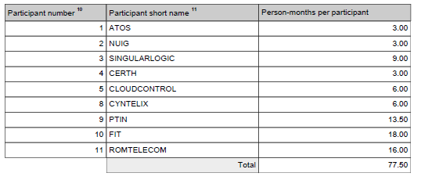
Effort distribution
7

Slide 8
Open issues / dependencies
Availability of
existing showcases
infrastructures and prototypes
8

